Slide 1
Tech Yourself Before You Wreck Yourself
Go to www.pitopiapercussion.com for presentation!
Using GarageBand and an iPad to Connect Your Musicians, Non-musicians and Your School
Presenter: Dan Bryan, Modesto City Schools

Slide 2
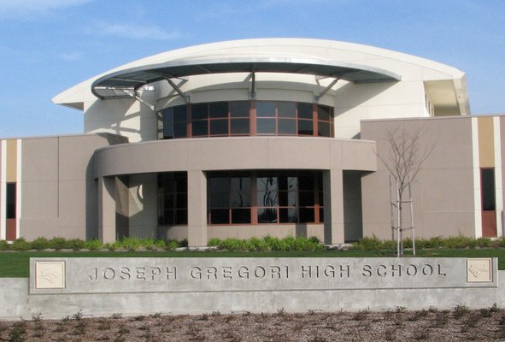
Gregori High School Overview

Slide 3
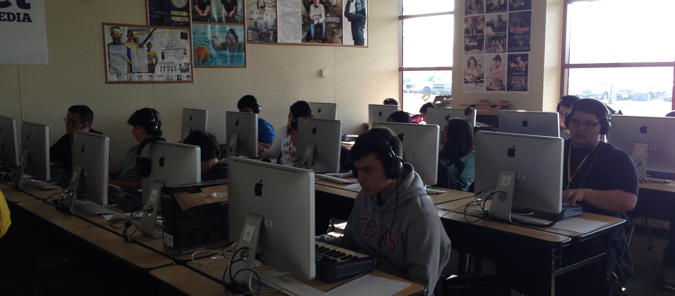
The beginnings…

Slide 4
Dan’s GarageBand FYIs
Exclusive GarageBand usage
Mac interface (PC platforms can have comparable programs but not specifically GarageBand)
iPad interface can be frustrating

Slide 5
What do we want kids to do
Play in time
Listen
Create
Practice

Slide 6
How to use GarageBand
Rhythm trainer
Warm up facilitator
Improv catalyst
Recording and school outreach

Slide 7
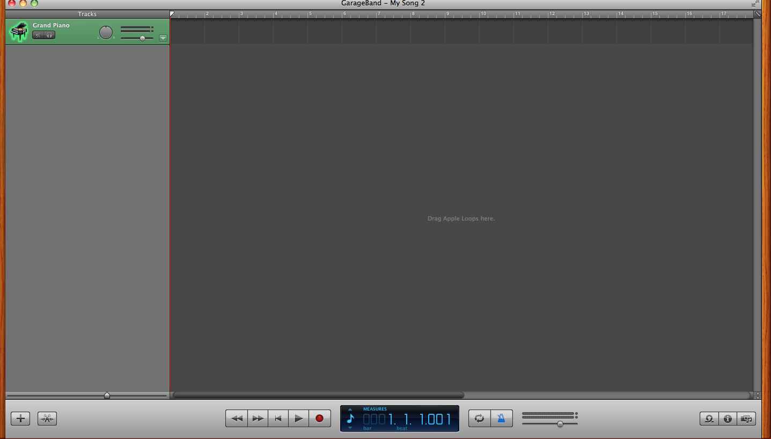
The Basics

Slide 8
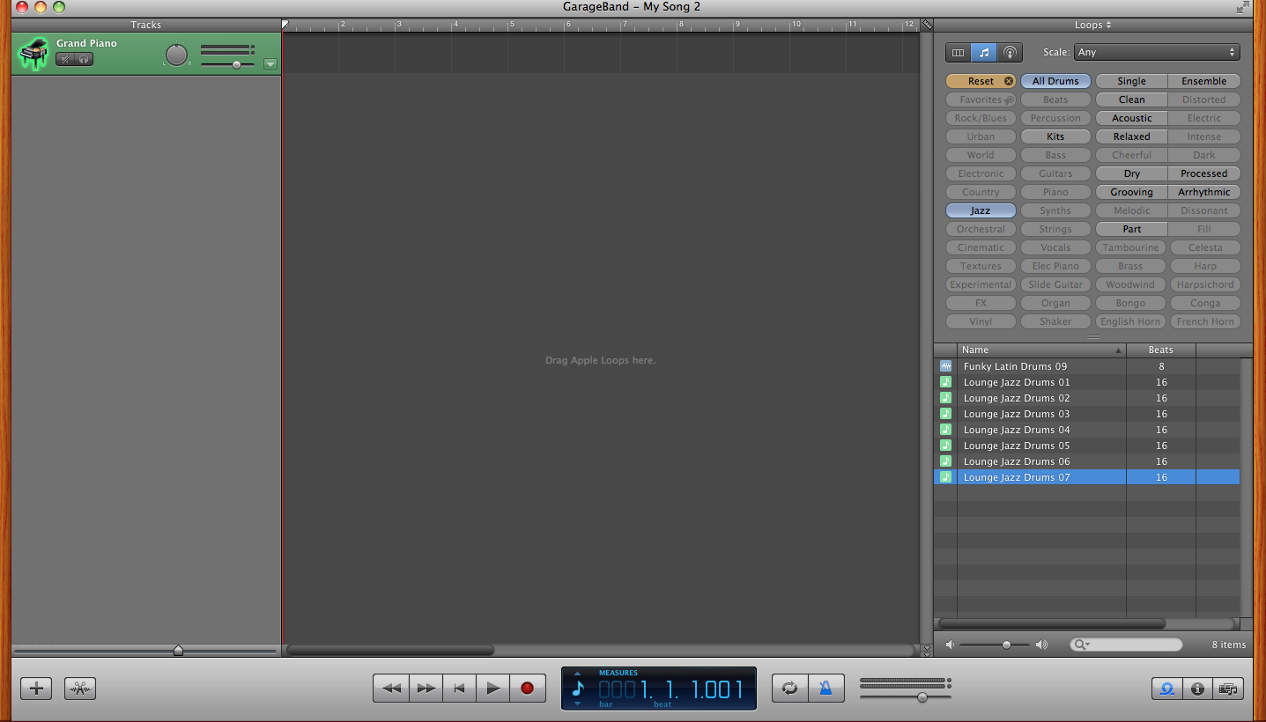

Slide 9
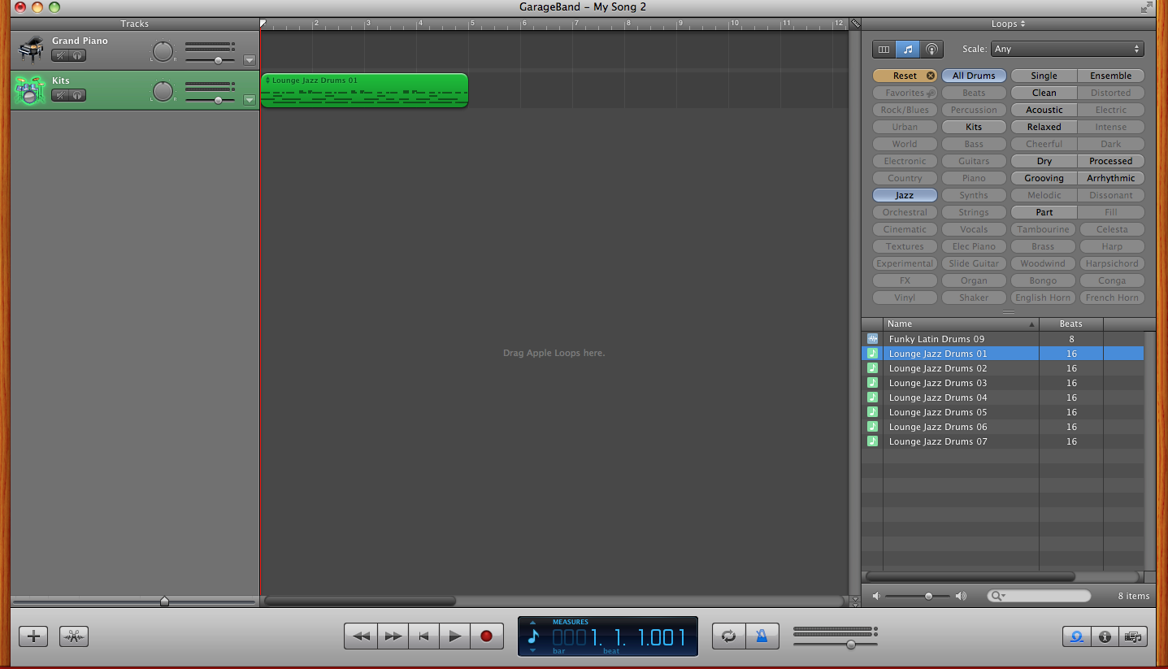

Slide 10
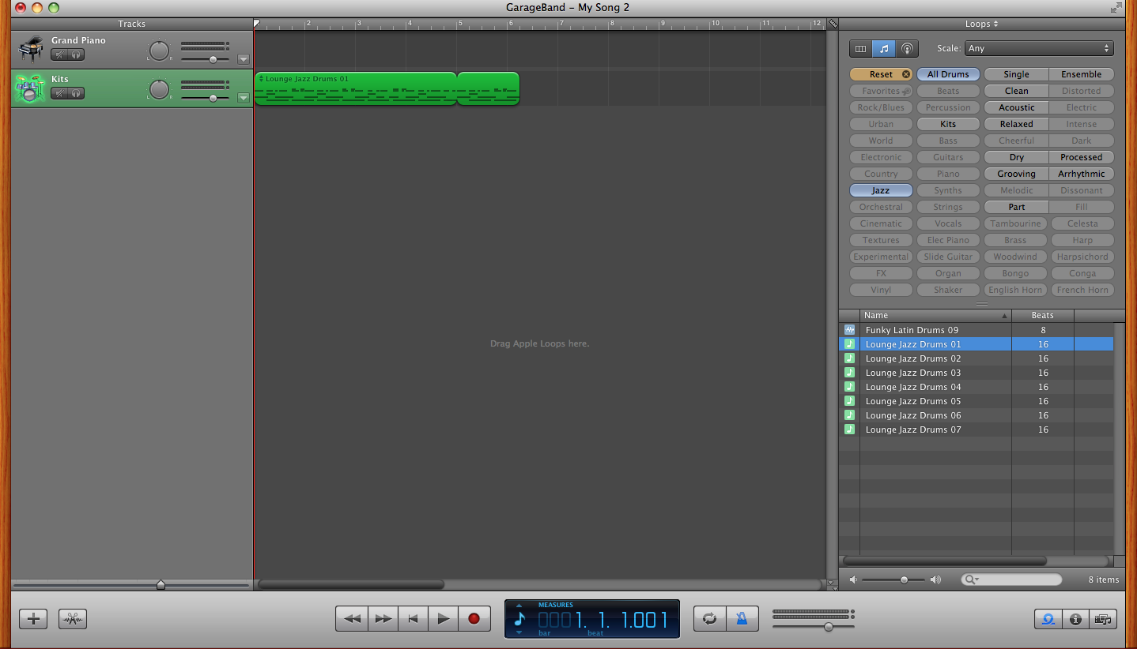

Slide 11
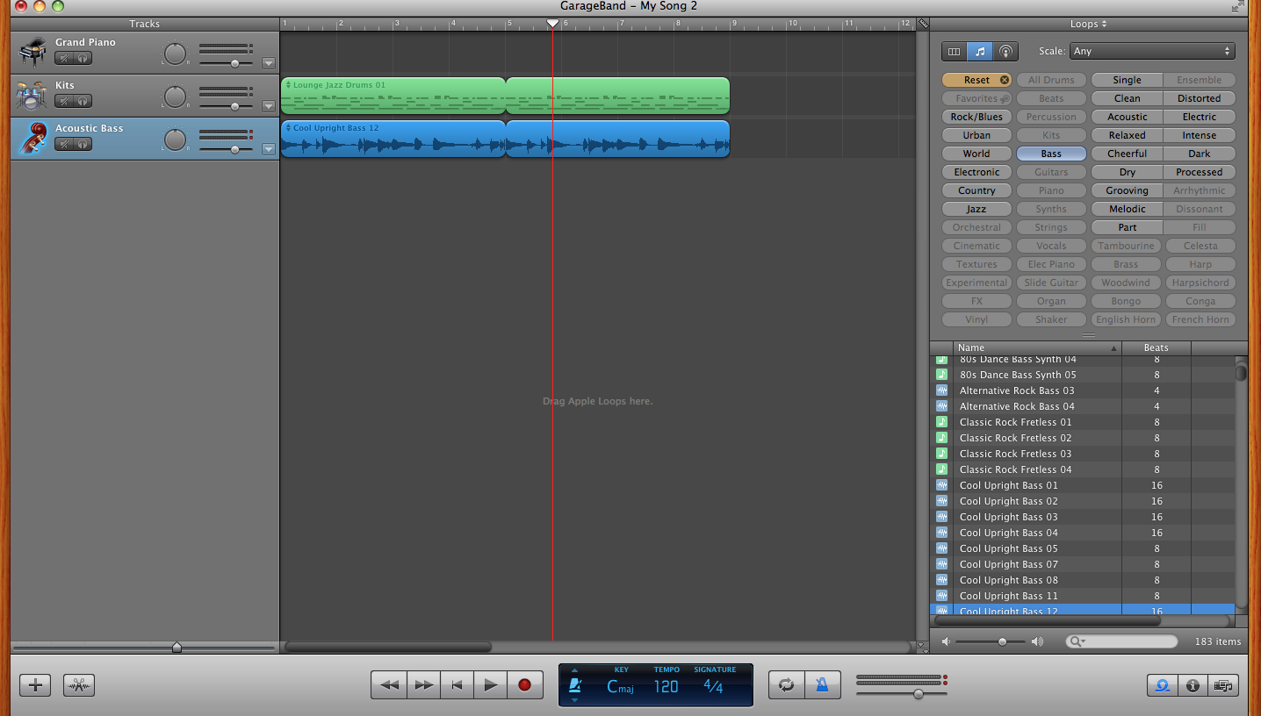

Slide 12
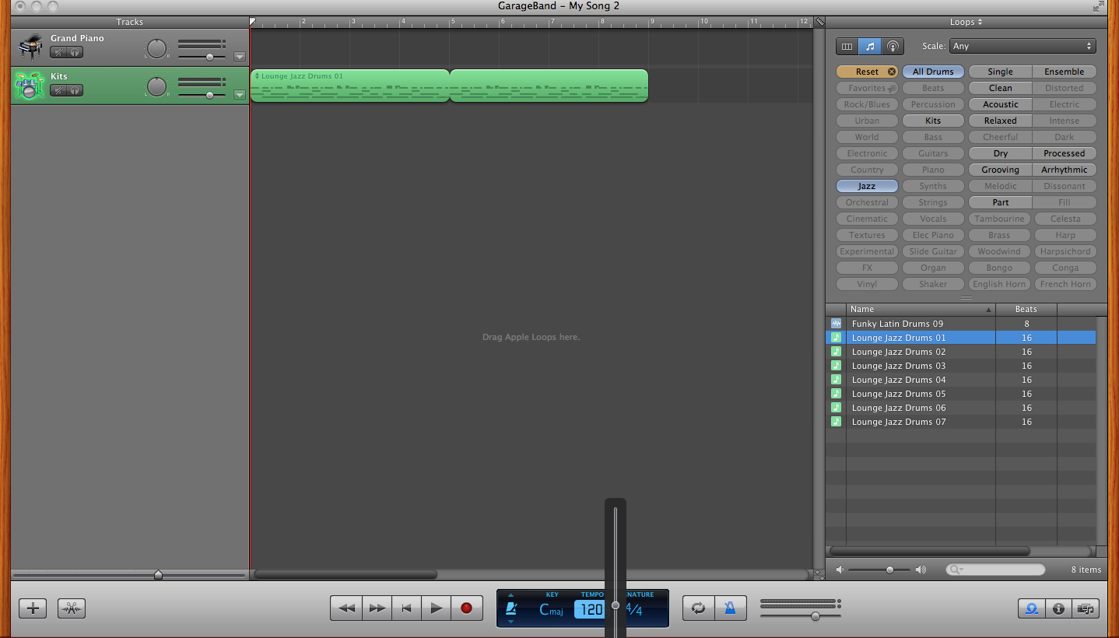

Slide 13
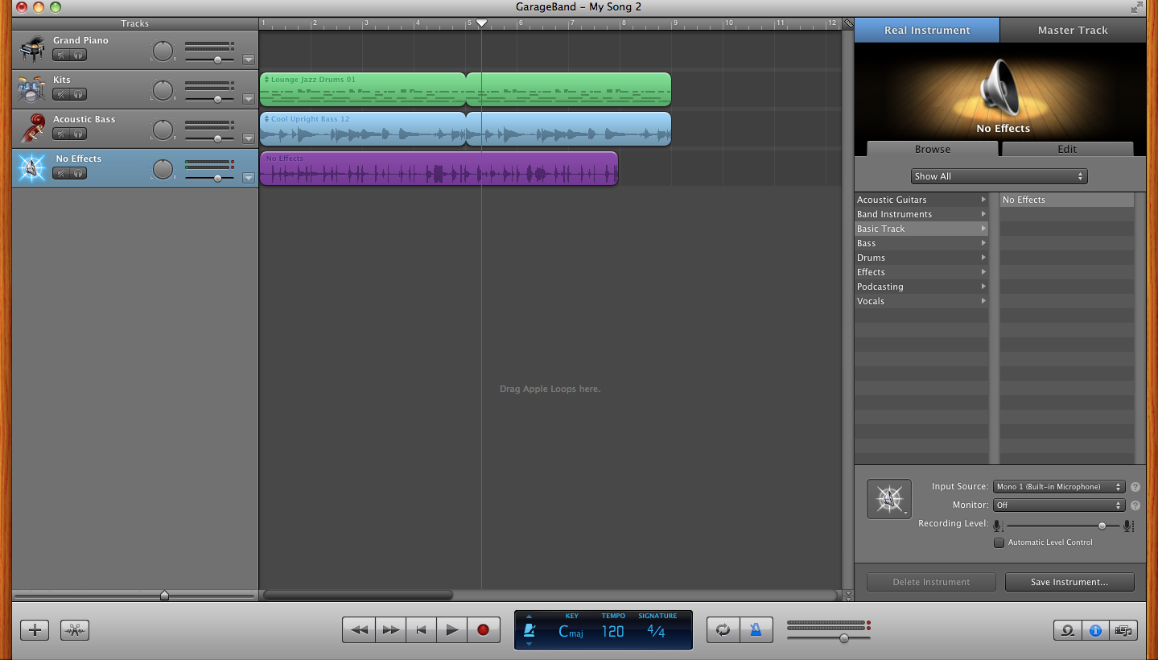

Slide 14
Using GarageBand as a rhythm teacher
Can use any written rhythm source-no SmartMusic necessary
Students can record using their own instrument using the internal mic on their computer/iPad
Can play with a pre-recorded track or solo

Slide 15
Warm up facilitator
Choose the groove of the day (or the week). Kids can choose it, too!
Amplify – Long Ranger/sound cart, etc.
Find a place in the room (generally in back, but can move around)
Frees you up to listen, make changes, hands, etc.

Slide 16
Improv catalyst
Pick a style
Keep it short
Add drums, bass, piano gradually
Helps transition them into live soloing – builds a “tool box”. And…they can do it over and over!

Slide 17
Campus outreach/etc.
Practice aid!
Music Tech – music for events, broadcasts, morning announcements, class projects.
Music Tech – the course…
Recruit for the department!
Bring up the cool factor!

Slide 18
Questions/Demo Time
Presentation at pitopiapercussion.com
209 761 5162
Email at bryan.d@monet.k12.ca.us or dbryan1109@aol.com. Facebook and website contact okay, too!
Giants > Dodgers

